Slide 1
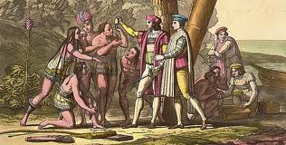
Unit I
Different Worlds Meet
Created by Mr. Dalton
www.mrdaltonsclass.com

Slide 2
Unit I Standards
SS.8.A.1.1: Provide supporting details for an answer from text, interview for Oral history, check validity of information from research/text and identify strong vs. weak arguments.
SS.8.A.1.2: Analyze charts, graphs, maps, photographs and timelines; analyze political cartoons; determine cause and effect.
SS.8.A.1.3: Analyze current events relevant to American History topics through a variety of electronic and print media resources.
SS.8.A.1.4: Differentiate fact from opinion, utilize appropriate historical research and fiction/nonfiction support materials.
SS.8.A.1.5: Identify, within both primary and secondary sources, the author, audience, format, and purpose of significant historical documents.
SS.8.A.1.6: Compare interpretations of key events and issues throughout American History.
SS.8.A.1.7: View historic events through the eyes of those who were there as shown in their art, writings, music, and artifacts.

Slide 3
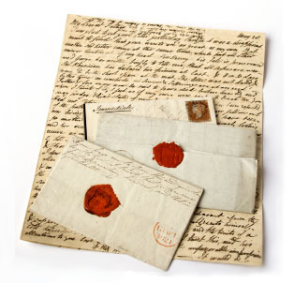
Primary vs. Secondary Sources (project) (10pts)
Copy down the following directions to complete the project for homework.
Visit the following website(s),
http://www.mrdaltonsclass.com/primary-vs-secondary-sources.html
http://www.ithacalibrary.com/sp/subjects/primary
After reading the website use the internet to find 5 Primary Sources, and 5 Secondary sources, list the link and write 2-3 sentences describing why this is a credible source.
E-mail (or turn in) the websites of the 5 primary and 5 secondary sources to
  Jdalton@rivercityscience.org

Slide 4
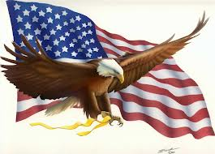
Warm Up
Warm up Questions:
What are the categories for your grades in this class?
What website can be used for study materials, make up assignments, and extra credit opportunities?
OCSR: What was the most interesting thing you learned in your Social Studies class last year?
Define: No vocabulary definitions today.

Slide 5
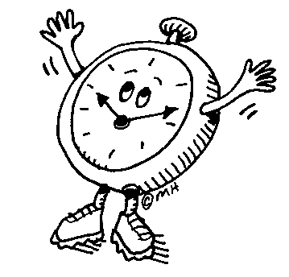
Daily Question to Know
Have people always told time from a clock? Have they always measured distances in the same way?
SS.912.W.1.2: Compare time measurement systems used by different cultures.

Slide 6
Units of Measurement and Time
Time
Distance
Second
Minute = 60 seconds
Hour = 60 minutes
Day = 24 Hour
Year = 365 Days
Decade = 10 Years
Century = 100 Years
Millennium = 1000 Years
10 millimeters (mm) | = 1 centimeter (cm)
10 centimeters | = 1 decimeter (dm) = 100 millimeters
10 decimeters | = 1 meter (m) = 1000 millimeters
10 meters | = 1 dekameter (dam)
10 dekameters | = 1 hectometer (hm) = 100 meters
10 hectometers | = 1 kilometer (km) = 1000 meters
Units of Measurement and Time Handout (15pts)

Slide 7

Roman Numerals
Roman Numerals come from the Ancient Roman number system.
These are the first 10 Roman Numerals
I
II
III
IV
V
Higher Number Roman Numerals.
L = 50
C = 100
D = 500
M = 1,000
VI
VII
VIII
IX
X
What is this number?

Slide 8
Roman Numeral Practice
XIV = ???
XXX = ???
MCI = ???
MMM= ???
XM= ???
If you have a X with an I in front of it, it is 9. Why?
What about IV?
Write the Roman Numeral for the following Numbers.
100
150
14
17
1456
2540

Slide 9
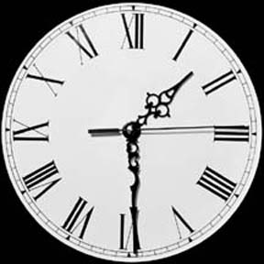
Roman Numerals on a Clock
One of the main places you will encounter Roman Numerals will be on clocks.

Slide 10

Warm Up
Warm up Questions:
Why should you research key terms before studying a certain subject?
What is the difference between academic vocabulary and your everyday vocabulary?
OCSR: Describe a scenario where you would use academic vocabulary in a non academic situation.
Define: Archaeology, Artifact

Slide 11

Question:
Describe the proper way to look up a definition from a text book.
SS.8.A.1.6: Compare interpretations of key events and issues throughout American History.
Daily Question to know

Slide 12
Unit I Vocabulary (26pts)
Juan Ponce de Leon
Montezuma
Ferdinand Magellan
Astrolabe
Caravel
Pilgrimage
Mosque
Conquistador
Pueblo
Mission
Plantation
Archaeology
Artifact
Ice Age
Migration
Culture
Civilization
Theocracy
Hieroglyphics
Terrace
Drought
Adobe
Federation
Bartholomeu Dias
Vasco da Gama
Christopher Columbus
If you copy the definitions directly from the text book, you will only receive 50% of the points. Use your own words to define.
Vocabulary Poster = 10pts
Front of Paper
Back of Paper
Word
Picture
Definition: This is where you write the definition of the word. USE YOUR OWN WORDS, NOT THE TEXTBOOK DEFINITION.
Word

Slide 13
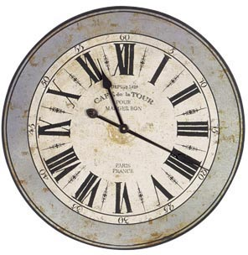
Warm Up
Warm up Questions:
Write down the Roman Numeral for 2013.
Draw a picture of a clock with the time being 6:45 (Label w/ ROMAN NUMERALS)
OCSR: What are the three branches of American Government and what are each responsible for?
Define: Civilization, Ice Age

Slide 14
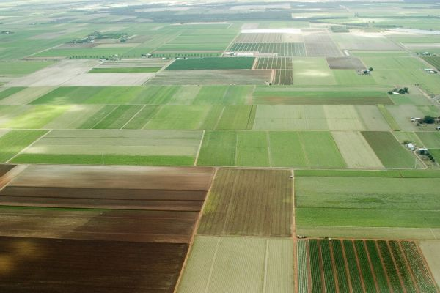
Question:
Why are timelines an essential component for the study of history?
SS.8.A.1.6: Compare interpretations of key events and issues throughout American History.
Daily Question to know

Slide 15
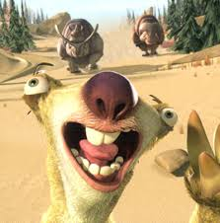
Unit I; Timeline Tutorial Project (30pts)
Aztec Establish Tenochtitlan***
Inca Empire begins to Expand
Maya empire reaches peak.***
Asian hunters enter north America***
Last Ice Age ends
The Crusades begin
Rise of Olmec in Mexico
Using your textbook;
Put these events in the right chronological order,
Also include a picture symbolizing EACH event.
and write 2-3 sentences briefly describing the events marked with***.

Slide 16
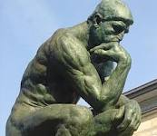
Warm Up
Warm up Questions:
Approximately when did the last Ice Age end?
What are the names of your teachers this year?
OCSR: What were the names of your teachers last year?
Define: Culture, Hieroglyphics

Slide 17

Question:
What does it mean to place events in Chronological order?
SS.8.A.1.6: Compare interpretations of key events and issues throughout American History.
Daily Question to know

Slide 18
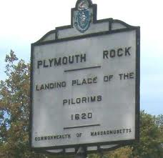
Unit I Timeline Project (30pts)
Using your textbook;
Put these events in the right chronological order,
Also include a picture symbolizing EACH event.
and write 2-3 sentences briefly describing the events marked with ***.
Iroquois form League of Five Nations
Jamestown Settled***
England defeats Spanish Armada
John Cabot sails to Newfoundland
Christopher Columbus reaches America***
Martin Luther promotes church reform
Pilgrims found Plymouth***

Slide 19
Unit V Timeline Poster Homework (10pts)
Your homework assignment is to find an event dating from 10,000BC-5000 BC ,
(NON AMERICAN HISTORY)
NOT ON THE TIMELINE PROJECT and create a poster board event.
Your event should look similar to those on the wall already.
Included must be;
  Date, name of event, picture.
  Sheet should be approximately ¼ sheet of paper.
  Some projects may be put onto the timeline wall.
  I encourage you to look for really cool interesting events.
Name of Event
Date of Event
¼ Sheet of Paper
Picture of Event

Slide 20
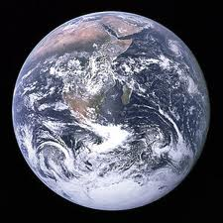
Warm Up
Warm up Questions:
What do you think the circumference of the World is in Miles?
What was the most interest timeline event we have studied so far, why?
OCSR: What event did you choose for your timeline homework? Why?
Define: Astrolabe, Archaeology

Slide 21
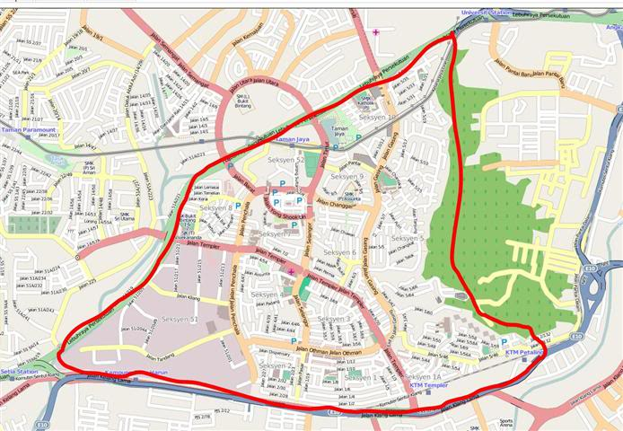
Question:
How are maps useful? Name at least three different events you could use a map for.
SS.8.A.1.6: Compare interpretations of key events and issues throughout American History.
Daily Question to know

Slide 22
Warm Up
Warm up Questions:
What is the KEY on a map?
Why is it important to know how to read a map, and not just follow a GPS?
OCSR: Who is the current President, who is the current vice President?
Define: Caravel, Ice Age

Slide 23
Question:
What are the seven continents? How many Olympic rings are there… what do these rings symbolize?
SS.8.A.1.6: Compare interpretations of key events and issues throughout American History.
Daily Question to know

Slide 24
Units of Time and Measurement Quiz
Handout Quiz

Slide 25
World Map Project (40pts)
Physical Features | Rivers/Water | Countries/Places | Countries/Places
Rocky Mountains Appalachian Mountains Himalayan Mountains Sierra Nevada Mountain Range Mt. Everest Mt. Kilimanjaro | Nile River Mississippi River Amazon River Ganges River Yellow River Congo River Volga River | Greenland Sweden France Morocco Botswana Sudan China Japan Mexico Greece *** Label the SEVEN CONTINENTS*** | Italy Egypt Vietnam Iraq India Venezuela Canada U.S.A. Brazil Spain
Label on a map ALL of the requested items. Label them with their correct number. For the Countries/Places outline or color them all a separate color and create a KEY that makes them easily identifiable.

Slide 26
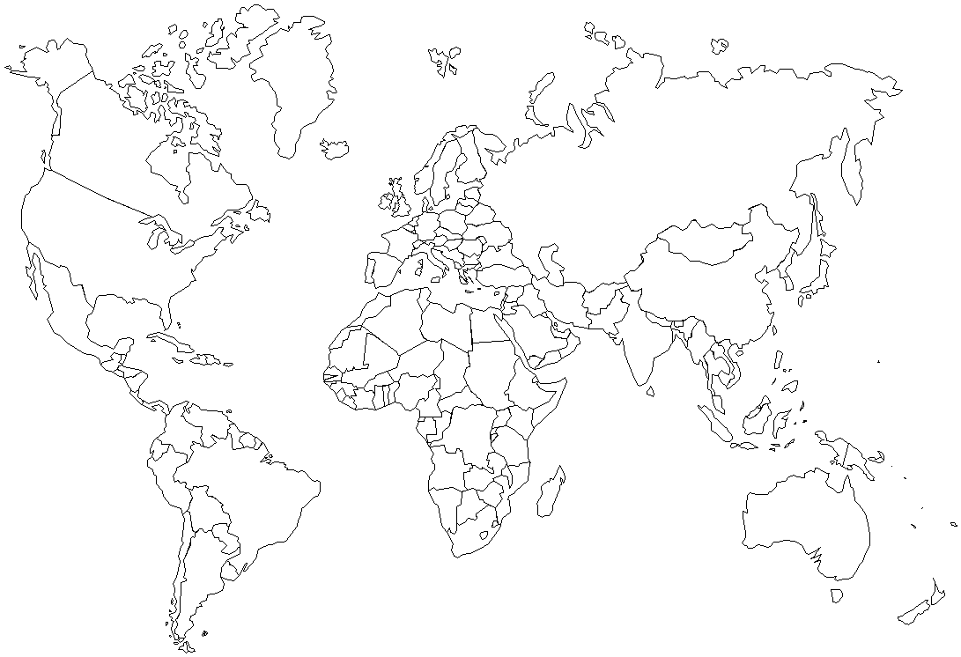

Slide 27
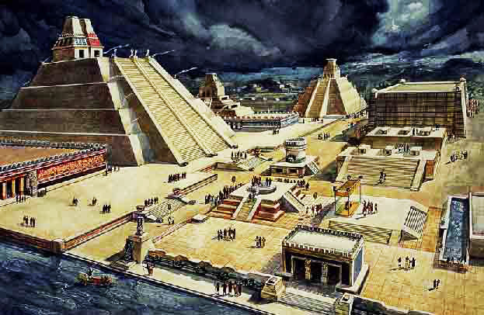
Warm up:
Warm up Activity:
What was unique about the Aztec Capital Tenochtitlan?
What is Christopher Columbus known for?
OCSR: Explain the importance of timelines.
Define: Civilization, Ice Age.

Slide 28
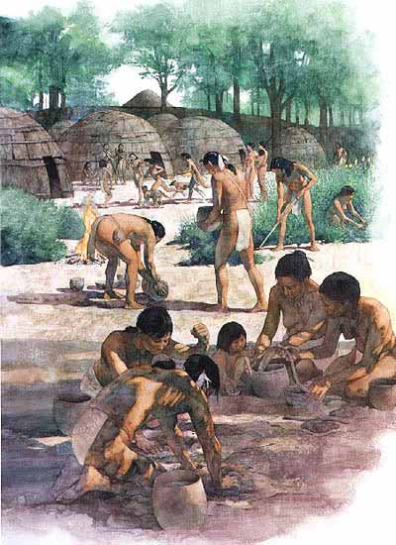
Question:
What were some of the major advancements that allowed people to live in permanent settlements?
SS.8.A.1.6: Compare interpretations of key events and issues throughout American History.
Daily Question to know

Slide 29
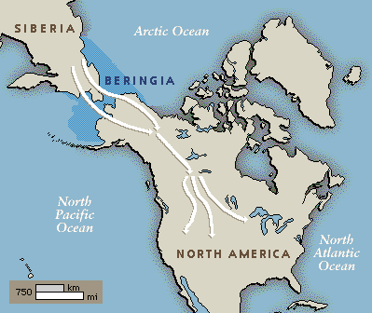
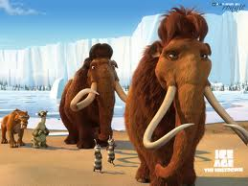
Early Peoples
The Journey from Asia.
  The first Americans arrived THOUSANDS of years ago.
  By 1500ad millions of Native Americans lived on North and South America.
  It is suspected that the early people crossed a land bridge between Siberia and Alaska.
    They did this to find food during an Ice Age.

Slide 30
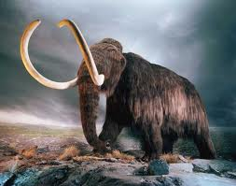
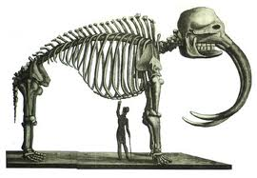
Early Americans
Early Americans were Nomads (people who moved place to place).
  They were also hunter-gatherer societies.
  They hunted things such as the Wooly Mammoths.
  They used spears to kill bison, mastodons, and mammoths. They used the spears as throwing weapons.

Slide 31
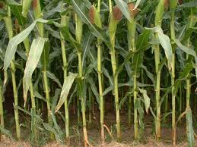
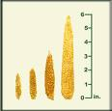
Early Americans
As the large animals disappeared they had to find new sources for food.
  Deer, birds, rodents, fish, and smaller game.
The BIG discovery however was in Mexico where they discovered how to plant and grow Maize (corn).
  They also grew pumpkins, beans, squash.
With the surplus of food, the population began to increase.

Slide 32
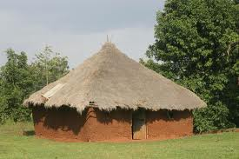
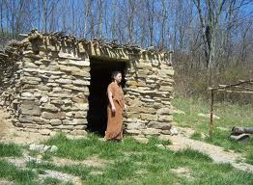
Permanent Settlement
Since these people knew they would have food from their harvest they began to create permanent houses, and to expand their culture.
  These houses were made of clay, brick, wood, stone.
Agriculture changed the culture by allowing these people to have more free time.

Slide 33
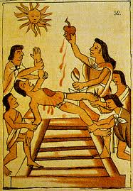
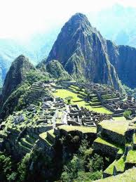
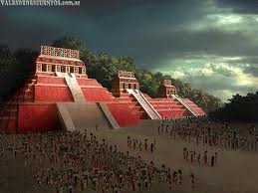
Early American Civilizations
Thee major civilizations existed in the Americas, they were the Mayas, the Aztecs, and the Incas.

Slide 34
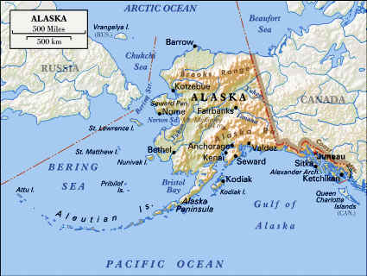
Warm Up:
Warm up Activity:
How did the first people arrive in the Americas?
Describe how a surplus of food allows a culture to develop and thrive?
OCSR: Who is legally allowed to vote in America? What is an exception to this rule?
Define: Adobe, Culture

Slide 35
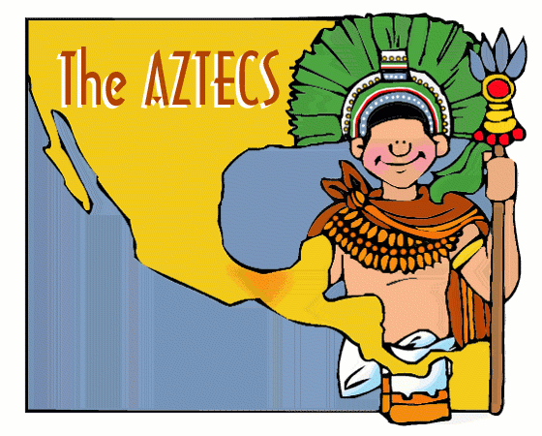
Question:
Put the following civilizations in the correct chronological order;
  Mayas, Incas, Aztec, Anasazi
SS.8.A.1.2: Analyze charts, graphs, maps, photographs and timelines; analyze political cartoons; determine cause and effect.
Daily Question to know

Slide 36
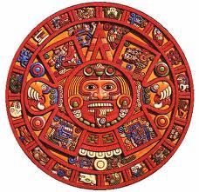
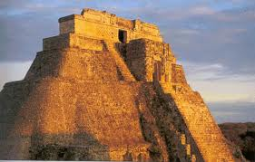
The Maya
The Maya were in present-day Mexico.
They planted;
  Maize (corn), beans, sweet potatoes.
They were ruled by their religious leaders. (Theocracy)
They also were advanced scientifically and created and used a very accurate system for telling time/calendar.
The Maya civilization began to decline in 900ad.
Mayan Calendar

Slide 37
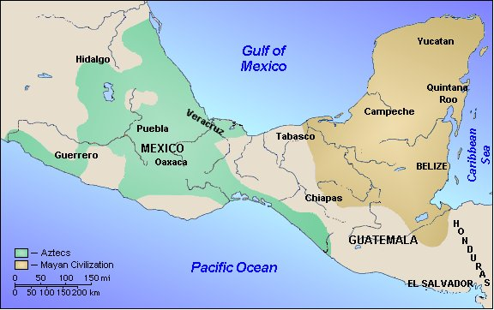

Slide 38
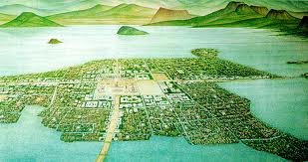
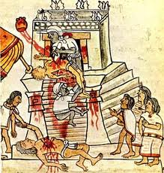
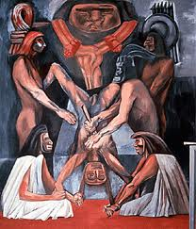
The Aztec
The Aztec civilization began in the 1300’s.
The built their capital on an island in the middle of Lake Texcoco.
  Their capital was called Tenochtitlan.
  At its height Tenochtitlan was the largest city in the Americas.
  The Aztecs were conquered by the Spanish Conquistador Hernan Cortes.
    They didn’t put up much of a fight because of disease and the Spaniards superior weapons.
Aztec Human Sacrifice Worksheet (24pts)

Slide 40
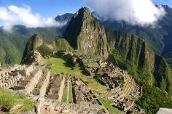
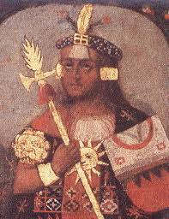
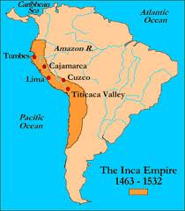
The Inca
The Inca Empire became the largest of the three.
Their capital was Cuzco. They had an excellent emperor named Pachacuti, he helped to build a militaristic empire.

Slide 42
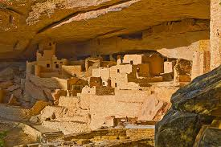
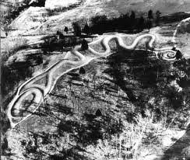
North American People
North American civilizations were also flourishing long before Europeans crossed the Atlantic Ocean.
Some of the most advanced cultures were the Hohokam, Anasazi, and the Mound Builders.
Anasazi Cliff Dwellings

Slide 43
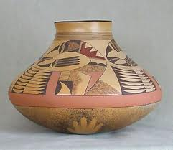
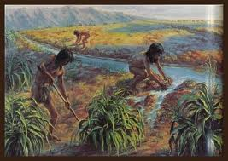
The Hohokam
They lived in present day Arizona. They flourished from 300ad-1300ad.
They were very advanced at utilizing irrigation systems.
They also left behind a lot of pottery and art.

Slide 44
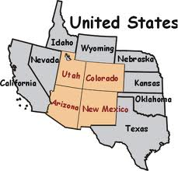
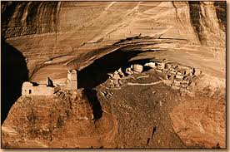
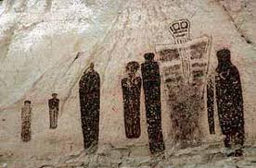
The Anasazi
The Anazazi were present during the same time as the Hohokam (300-1300ad).
They lived in the “Four Corners” area. (Present day Utah, Colorado, Arizona, and New Mexico.
The Anaszai lived in Cliff-dwellings.

Slide 45
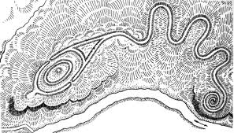
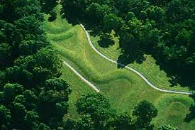
The Mound Builders
Adena and Hopewell were two of the groups known as the mound builders. They built mounds similar to the stone pyramids of the Maya and Aztecs.
The Great Serpent Mound looks like a giant snake winding across the ground.

Slide 46
MAP QUIZ (15pts)

Slide 47
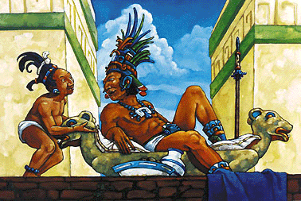
Warm Up:
Warm up Activity:
Who came first the Mayas, the Aztecs, the Incas?
What are your own personal opinions about religious/political reasons for Human Sacrifice?
OCSR: How are culture, religion, ethnicity, and nationality alike and different?
Define: Conquistador, Montezuma

Slide 48
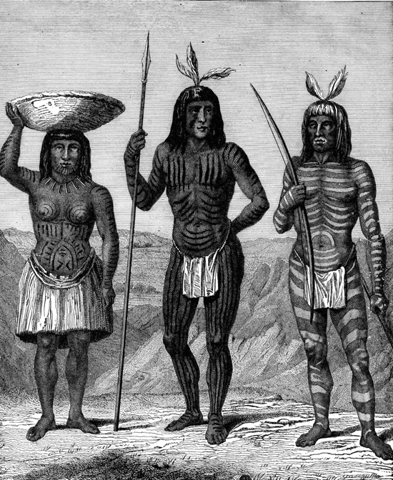
Question:
Why would smaller tribes pay tribute to larger tribes? Do modern societies still do something similar to this?
SS.8.A.1.6: Compare interpretations of key events and issues throughout American History.
Daily Question to know

Slide 49
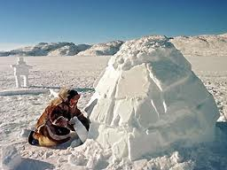
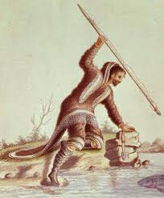

Other Native North Americans
The Inuit people lived way up in North America, around the Arctic Ocean.
They built Igloos and their clothing was made of furs and sealskin (was warm and waterproof).
They were expert hunter and fishers.

Slide 50

Inuit People

Slide 51


Peoples of the West
Tlingit, Haida, and Chinook developed a way of life that used the resources of the Forest and the Sea.
They had wooden houses, canoes, and used spears and nets.
They fished a lot of Salmon.

Slide 52


People of the Southwest
These people were descendents of the Anasazi. The Hopi, Acoma, and the Zuni.
They built their homes out of a type of mudbrick called Adobe.
They raised a wide variety of crops.
These people were joined in the 1500’s by the Apache and the Navajo.
  Unlike the others the Apache and Navajo were hunter-gatherer societies.

Slide 53


Peoples of the Plains
The peoples of the Great Plains (central north America) were Nomadic.
When they moved they brought with them EVERYTHING. They also lived in tepees.
Eventually these people became skilled horse riders and hunted while on horseback. They also utilized horses during warfare.

Slide 54
Peoples of the East and Southeast
These people had a much more complex political systems.
The Iroquois and Cherokee
  They utilized many law codes and federations that linked different groups.
Iroquois Nations
  Onondaga, Seneca, Mohawk, Oneida, Cayuga.
  These were all tribes that were once at war, then were united in the Iroquois League.

Slide 55
First Americans Review (12pts)
Answers should be 2-3 sentences each.
For what reasons did Asians cross the land bridge to the Americas?
What was the first crop raised by Native Americans in Mexico?
Who came first the Mayas or the Aztecs?
What does it mean to be Nomadic?
How do hunter-gatherer societies differ from societies that grow crops?
How does growing crops allow your population to expand?

Slide 56
Native Americans Map Project
Using a blank world map and our previous notes identify on a map the following tribes/peoples.
Inuit Haida and Tlingit Maya Inca | Hohokam Apache Navajo Aztec

Slide 57


Slide 58

Warm Up:
Warm up Activity:
The Mayas are talked about in the news all of the time, why are people still talking about them?
Do you see any reason that the Aztec’s could NOT have made a city out of solid gold?
OCSR: How many official jobs does the Vice President have according to the constitution?
Define: Drought, Federation

Slide 59

Question:
How does repetition help you to remember certain things? Does this method work for everybody?
SS.8.A.1.6: Compare interpretations of key events and issues throughout American History.
Daily Question to know

Slide 60
Unit I Vocabulary Bingo!!!
Create a bingo chart similar to the one below. You may need to use words multiple times. You can’t use any word more than twice. Place them in a random order!!!
Archaeology
Artifact
Ice Age
Migration
Culture
Civilization
Theocracy
Hieroglyphics
Terrace
Drought
Adobe
Federation
Bartholomeu Dias
Vasco da Gama
Juan Ponce de Leon
Montezuma
Ferdinand Magellan
Astrolabe
Caravel
Pilgrimage
Mosque
Conquistador
Pueblo
Mission
Plantation
Christopher Columbus
B I N G O

Slide 61

Warm Up:
Warm up Activity:
What is a unique characteristic of the Anasazi tribe?
What is an Indian tribe that is native to Florida?
OCSR: When would a Vice President take over for the President? (list two scenarios)
Define: Hieroglyphics, Theocracy

Slide 62

Question:
What sort of grade should you get on a take home exam? Why?
SS.8.A.1.6: Compare interpretations of key events and issues throughout American History.
Daily Question to know

Slide 63
VOCAB QUIZ (16pts)
When you get to this slide do the vocabulary Bingo, then the quiz the following day.

Slide 64
QUIZ BREAK
Anything above this slide is eligible to be on the quiz for Unit I.

Slide 65

Warm Up:
Warm up Activity:
Why were many Native American tribes Nomadic?
How could a society change if it was in one permanent location, why?
OCSR: Describe the steps needed to create a vocabulary poster.
Define: Christopher Columbus, Caravel

Slide 66
Warm Up:
Warm up Activity:
How were the members of the Iroquois nation a more complex culture than previous tribes?
What does it mean to be nomadic and which of the discussed tribes were nomads?
OCSR: How is the President of the United States elected?
Define: Caravel, Conquistador

Slide 67

Warm Up:
Warm up Activity:
What is a privateer, how did you know this from the reading?
Why is not always a good idea to have your family work with or for you (think of Columbus’ brothers)?
OCSR: During the Age of Exploration how many continents did they think there were in the world? What were they?
Define: Pilgrimage, Mission

Slide 68

Question:
What were the reasons that people began to explore the world?
SS.8.A.1.6: Compare interpretations of key events and issues throughout American History.
Daily Question to know

Slide 69
Question:
What are three interesting facts about Columbus that you did not know prior to reading his biography?
SS.8.A.1.6: Compare interpretations of key events and issues throughout American History.
Daily Question to know

Slide 70

Question:
Which of the three explorers studied today made the ‘riskiest’ voyage? Explain how/why.
SS.8.A.1.6: Compare interpretations of key events and issues throughout American History.
Daily Question to know

Slide 71



Reasons for Exploration
Three G’s
God, Glory, Gold.
Merchants could make tons of money selling goods from the Orient. If they had direct routes they could cut out the middle man and make more money.
People wanted to spread Christianity.
During this time the Renaissance was in full swing in Europe. They wanted to continue to develop and utilize new technologies.

Slide 72


Technology Allowed for Exploration
Latitude and Longitude Map Homework (15pts)
Coming out of the Renaissance there was an abundance of new technology that allowed for easier exploration.
Better Maps and better ships were the two main advances which allowed for exploration.
  Maps began to show the direction of ocean currents, and lines of latitude. They also began to use a compass.

Slide 73


African Trading Kingdoms
The African Kingdoms on the west coast of Africa also benefited from these new technologies.
They traded gold, copper, and Iron with Islamic nations, as well as European nations.
Eventually they traded what?
  Slaves.
How did the Slave trade begin?

Slide 74

Early Exploration
When Columbus and other early explorers began to sail, their maps only showed three continents.
  Europe, Asia, and Africa.
  They also did not realize how large the oceans actually are.
  Do we really know anything about oceans today?
Causes of European Exploration European desire for new trade routes (mostly to the orient) Growing power and wealth of European nations. Competition for trade. Missionaries’ desire to convert others to Christianity
Effects of European Exploration Knowledge grows about other regions. Europeans and Native Americans clash. Enslavement of Africans Rivalry in the Americas grows.

Slide 75


Early Explorers
Bartholomeu Dias (Portugal, 1487)
  Sent to explore the southernmost part of Africa. (Cape of Good Hope)
Vasco da Gama (Portugal, 1497)
  Sent from Portugal with four ships. Sailed around the Cape of Good Hope and visited cities along the coast of East Africa. Eventually making it to India.

Slide 76


Christopher Columbus
Christopher Columbus sailed for Spain even though he was Italian.
He thought he could reach Asia by sailing west.
Eventually Spain’s King Ferdinand and Queen Isabella funded Columbus plan to sail west to get east.

Slide 77


Christopher Columbus
On August 3, 1492 Columbus set sail from Spain with three ships.
  The Nina, The Pinta, and the Santa Maria.
Two months later Columbus and his crew spotted land in present day Bahamas.
Christopher Columbus Biography Homework (15pts)

Slide 78

Christopher Columbus Comic Strip/Story (20pts)
Comic Strip
Story
Create a comic strip with at least 8 events which shows Columbus voyage.
The events should span from the beginning to end of his exploration of the Americas. You can use your Christopher Columbus Biography to help you with this assignment.
Instead of creating a comic strip you can create a fictional story BASED OFF the life of Christopher Columbus. You should create your own characters, places, and reasons for exploration.
Minimum for this assignment is 1.5pages.

Slide 79
Explorers Foldable/Explorers Map (30pts)
Create a foldable or a tri-fold each of the following explorers should have their own section.
  Christopher Columbus
  Vasco da Gama
  Bartolomeu Dias
Inside of their foldable write 3-5 facts about each explorer, and draw a map of their route.
Also include 2-3 sentences about why their exploration was important to the western world.

Slide 80

Warm Up:
Warm up Activity:
Out of the previously discussed explorers, who do you think made the largest impact, why?
How does the phrase God, Glory, and Gold contribute to exploration?
OCSR: Which Native American tribe practiced human sacrifice, why did they do this?
Define: Conquistador, Mission.

Slide 81

Question:
How did the Spanish appear to the First Americans? Also what were the differences in technology between the Americans and Spanish?
SS.8.A.1.2: Analyze charts, graphs, maps, photographs and timelines; analyze political cartoons; determine cause and effect.
Daily Question to know

Slide 82



The Vikings
Centuries before Columbus had reached the Americas, the Vikings had visited Iceland and Greenland and established colonies.
The Vikings tried to establish permanent settlement in the Americas however they did not succeed. The “World” did not discover the Americas until Columbus’ voyage.

Slide 83



Spain in America
The Spanish had a large presence in the development of America.
Spanish Conquistadores came over to Central and Southern America and conquered the remnants of the Incas, and Aztecs.

Slide 84



Cortes Conquers the Aztecs
Hernan Cortes landed on the East Coast of Mexico in 1519. He like the other Conquistadores was after Gold and Glory.
He had roughly 500 soldiers, some horses, and some cannons.
Cortes made alliances with the small tribes that were conquered by the Aztecs. Eventually with the help of these tribes Cortes overthrew Montezuma (leader of the Aztecs)
This caused the Aztec Empire to dissipate and Spain gained control of the region.

Slide 85


Pizzaro Conquers Peru
Francisco Pizzaro was the downfall of the Incan Empire.
In 1532 he captured the Incan ruler Atahualpa and destroyed most of the Inca army.
Without an effective leader, Pizzaro and his troops quickly stomped out the Incas.

Slide 86
Technology Difference
Spanish Technology
Bows and Arrows
Inca Technology
Guns
Horses
Armor
Cannons
Ships
Spears
TERRIFIED of horses
Never had seen guns or armor.

Slide 87
Demonstration of Guns vs. Spears

Slide 88



Why did Spain Succeed
Why could the smaller Spanish Armies take over empires many times larger than them?
  Weapons (guns, cannons, horses)
  Assistance from other tribes (many tribes hated the Aztecs and united with the Spanish against them.)
  Disease (smallpox wiped out LARGE groups of Native Americans.)

Slide 89



Ponce De Leon
Pone De Leon made the first Spanish landing in North America. Present Day Florida.
He was searching for the Fountain of Youth.
In 1565 The Spanish established their first settlement in North America. St. Augustine.

Slide 90


The Viking Diaries (20pts)
Imagine you are a Viking (make up your own Viking name), your leader is a man named Leif Ericsson.
You were in a boat that consisted of a primitive sail and a bunch of oars, you were in the ‘open sea’ for several days not knowing exactly where you were going, then you arrive on a strange land where people speak in different languages, have different color skin, and are terrified of you.
Your assignment is to write a ‘diary’ (really you wouldn’t be writing you would be telling this story to your children/grandchildren upon your arrival home).
  Your story should be about what you experienced on the Voyage.
    This includes the way there, your time spent in the Americas, and your return trip. This should be 1-2pages in length, and written in the first person (I felt, I saw… etc)

Slide 91


Warm Up:
Warm up Activity:
What is smallpox, and what was its effect on the Native Americans?
Why could the conquistador’s conqueror the large Native American tribes with such a small force?
OCSR: Explain how a surplus in food and supplies can lead to a population surge.
Define: Plantation, Ferdinand Magellan

Slide 92

Question:
How did the Columbian Exchange work? What HUGE trading network do you think eventually will tie into the Columbian exchange? (Hint; from Africa)
SS.8.A.1.6: Compare interpretations of key events and issues throughout American History.
Daily Question to know

Slide 93


Slide 94


Spanish settlements
Spanish law called for three kinds of settlements in the Americas;
Pueblos
  Towns, and the center of trade.
Missions
  Religious communities, usually including a small town, farmland, and a church.
Presido
  Fort that was usually built by a mission.
San Jose Mission (California)

Slide 95


Encomienda and the Plantation System
In the 1500’s the Spanish government granted Conquistadores encomendia.
  This allowed them to demand taxes and labor from the Native Americans on their land.
Many plantations began to rise to export tobacco and sugarcane. A plantation is a large estate.
  Native Americans originally worked the farms, however they were eventually replaced by slaves from Africa.
Tobacco Leaves
Sugar Cane

Slide 96

The Columbian Exchange
Two parts of the globe were now connected. The Americas to the west, and Europe/Africa, to the east.
This led to an exchange of plants, animals, and diseases that altered life on both sides of the Atlantic.

Slide 97


Slide 98



More Countries begin to Settle
Portugal and Spain had a trade (The Treaty of Tordesillas) that split the Americas between Spain and Portugal.
However other nations completely ignored the treaty when the came to the Americas.
These other countries were England, France, and the Netherlands.

Slide 99


French Open Trading Posts
France had shown relatively little interest in establishing colonies in the Americas.
They viewed North America as an opportunity to make large profits selling furs, and trading fish.
Beaver pelts and furs were very popular in Europe and the French made large profits.

Slide 100


Dutch West India Company
The Dutch established a trading colonies in the Americas.
Like England, France, Spain, and Portugal they also established Permanent colonies.

Slide 101
Test Review Questions

Slide 102

Warm Up:
Warm up Activity:
Describe the technology difference between the Native Americans and their Spanish Conquerors.
Why did the small tribes around the Aztecs agree to join up with the Spanish to defeat the Aztecs?
OCSR: Which Conquistador was responsible for conquering the Incas.
Define: Conquistador, Ferdinand Magellan

Slide 103

Question:
Do you think reviewing your quiz will help you with your upcoming exam? Why/why not.
SS.8.A.1.6: Compare interpretations of key events and issues throughout American History.
Daily Question to know

Slide 104

Warm Up:
Warm up Activity:
Who sailed the longer voyage, Christopher Columbus, or Vasco da Gama?
Who funded Christopher Columbus’ voyage?
OCSR: On what continent is Brazil located?
Define: Ice Age, Mission

Slide 105
Question:
Was this jeopardy review game helpful for you? Why/why not.
SS.8.A.1.6: Compare interpretations of key events and issues throughout American History.
Daily Question to know

Slide 106
Jeopardy Review Game
Unit I Jeopardy Review

Slide 107

Warm Up:
Warm up Activity:
What are two facts about Christopher Columbus that you did not know prior to this class? (do not write nothing)
Who was the first sailor to sail around the world?
OCSR: What were the names of Christopher Columbus’ ships?.
Define: Ferdinand Magellan, Mission.

Slide 108

Question:
Did you enjoy the Jeopardy Review game? How will this game help you on your upcoming exam?
SS.8.A.1.6: Compare interpretations of key events and issues throughout American History.
Daily Question to know

Slide 109

Exam, good luck.

Slide 110

Next up Unit II: Colonial Settlement

